Slide 1
React Router

Slide 2

React Router
We need to go from one page to another: React Router lets us add paths!
It looks an awful lot like a component: <Router />
Notes:
111,382 downloads in the last day
588,193 downloads in the last week
2,297,472 downloads in the last month
22 open issues on GitHub
19 open pull requests on GitHub

Slide 3
React Router
import React,from 'react';
import { BrowserRouter as Router, Routes, Route } from 'react-router-dom';
const App = () => (
<Router>
<Suspense fallback={<div>Loading...</div>}>
<Routes>
<Route path="/" element={<Home />} />
<Route path="/about" element={<About />} />
</Routes>
</Suspense>
</Router>
);
Notes:
https://reacttraining.com/react-router/web/example/basic
Walk through the file.
We pass in a path name and a component to each Route “component” and we wrap these Route components in a Router (here, BrowserRouter)
BrowserRouter: A <Router> that uses the HTML5 history API (pushState, replaceStateand the popstate event) to keep your UI in sync with the URL.
Can take a number of optional arguments
Route: The Route component is perhaps the most important component in React Router to understand and learn to use well. Its most basic responsibility is to render some UI when a location matches the route’s path.

Slide 4
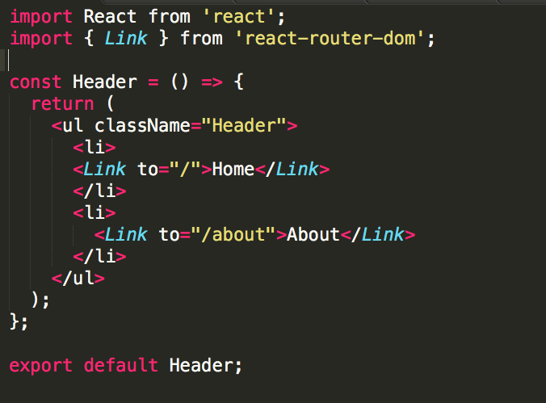
React Router
Notes:
https://reacttraining.com/react-router/web/example/basic
We pass in a path name and a component to each Route “component” and we wrap these Route components in a Router (here, BrowserRouter)
BrowserRouter: A <Router> that uses the HTML5 history API (pushState, replaceStateand the popstate event) to keep your UI in sync with the URL.
Can take a number of optional arguments
Route: The Route component is perhaps the most important component in React Router to understand and learn to use well. Its most basic responsibility is to render some UI when a location matches the route’s path.

Slide 5
Catstagram Recap - Thinking in React
What steps did we follow to build this app in two days?
Break the UI into a component hierarchy
Build a static (non-interactive) version in React
Identify the minimal (but complete) representation of UI state
Identify where your state should live
Incorporate state to make app interactive
Notes:
https://facebook.github.io/react/docs/thinking-in-react.html is an excellent source

Slide 6
Final React Class Survey! https://forms.gle/dndbdezDpxhch1CP6

